Slide 1
MOVIE TICKET BOOKING SYSTEM (DBMS)
BY,
ANISH MOHAN R R(RA2111003010566)

Slide 2
ABSTRACT
Movie Ticket Booking System is a computerized solution for theatre setups, which will automate the process of Ticket Sale and Customer Bookings. This application will allow users to browse movies _x000C_ltering them based on location, price, rating, genre, timing and age.
Provide customers with facilities to view movie availability online and make reservations with just a few steps.
Through this project we aim at implementing various Database Management System concepts like transaction management and Database security while improving our software development skills.

Slide 3
INTRODUCTION
Movie Ticket Booking Systems are used all around the world for booking and reserving movies online. These applications and websites provide customers with facilities to view movie availability online and make reservations with just a few steps.
The admin has the option to add and delete movies. The users can also reset their login password and change their pro_x000C_le picture in the website. The users also have the option of providing a feedback on the website experience through a feedback forum. This project replicates the working of a real life movie ticket booking system.

Slide 4
AIM
To create a dbms for Movie ticket booking system. Through this project we aim at implementing various Database Management System concepts like transaction management and Database security while improving our software development skills.
Configuration:
FRONT END : HTML, CSS,JS
BACK END : PYTHON
DBMS : MY SQL

Slide 5
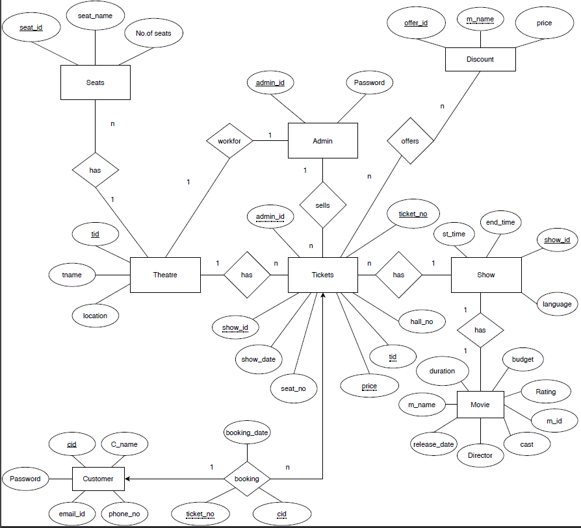
E-R DIAGRAM

Slide 6
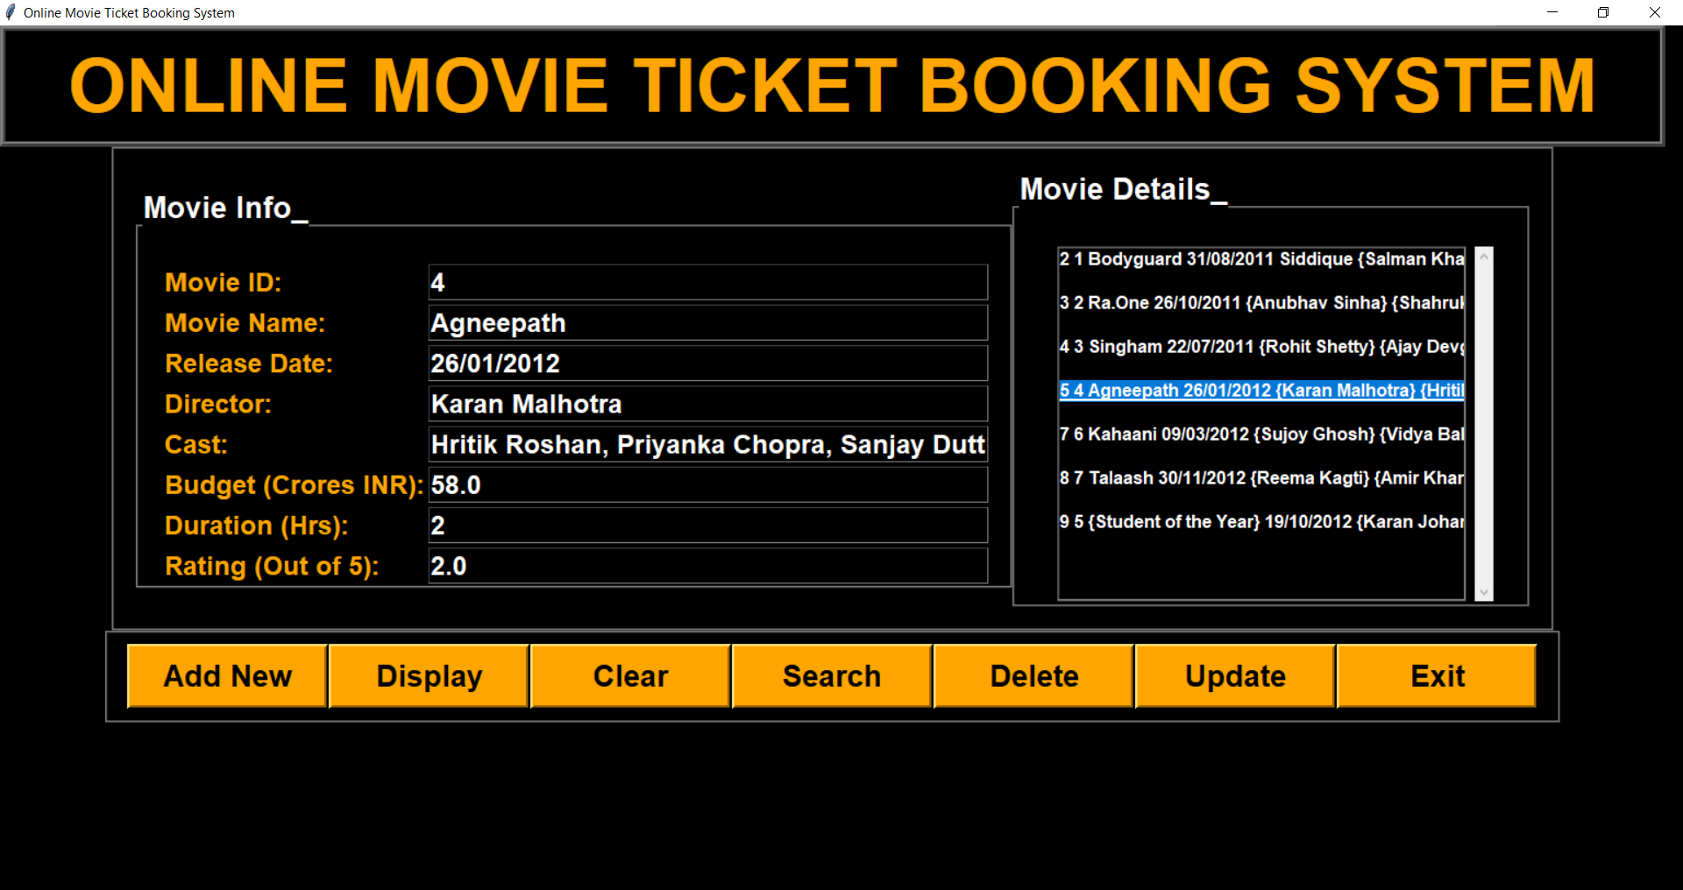
OUTPUT

Slide 7
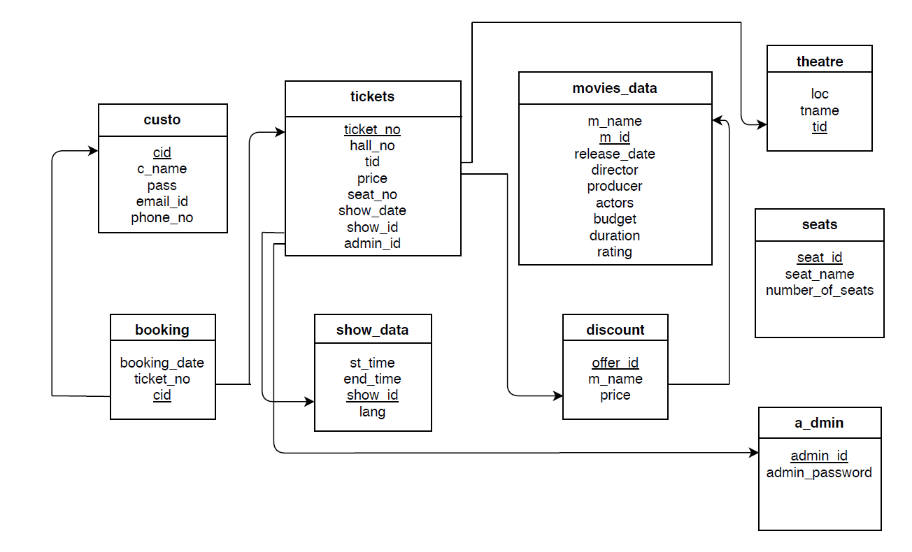
SCHEMA

Slide 8
THANK YOU

